Slide 1





AUTOMATED
LIBRARY SYSTEM
FINAL DEFENCE PRESENTATION
ON
INTELLIGENT
LIBRARY SYSTEM
‘INTELLIB’

Slide 2

GROUP MEMBERS
Karamveer Singh, 36017711622, AIML B
Vansh Sharma, 35817711622, AIML B
Anshul Bansal, 01917711622, AIML A
Sneha Bhasin, 04117711622, AIML A
Supervisor
Dr. Ashish Kumar

Slide 3


PRESENTATION OUTLINE
Introduction
Related Work
Problem Statement and Objectives
Project Analysis and Design
Hardware and Software Requirement Specifications
Use Case Diagrams, Flow Chart/ Activity Diagram
Proposed Work and Methodology Adopted
Results and Discussion
Conclusion
Future Scope of Work
References

Slide 4


INTRODUCTION
Our project, an intelligent library system, aims to revolutionize the way how libraries operates. The motivation behind this project is to streamline the process of issuing and returning books, making it more efficient and user-friendly. This system reduces manual work, saves time for both students and library staff, and minimizes human errors. By leveraging technologies like image recognition and database management, it aims to create a simple, cost effective solution that represents significant step towards digitizing libraries and making it more accessible and efficient for everyone.

Slide 5
INTRODUCTION
First, we’ll deploy a camera in the library, which will be used for two processes-
1) Book Issue Process:
We detect the enrollment number from the student’s college ID card image, and we also identify the book using bar code reader. Then, the book is issued under that student’s enrollment number.
2) Book return process:
In the book return process, the camera again detects the student’s enrollment number from their college ID card. We identify the book that student wants to return using the barcode. The system then verifies this information from the database where all the issue and return details are stored, and removes the book’s name from that student’s enrollment number.

Slide 6
INTRODUCTION
We will provide an application to the library that includes book issue and return processes, and updates all the information in the database. Additionally, we will provide an application to students where they can see their issued books under their enrollment number, as well as the deadlines for returning their currently issued books.

Slide 7

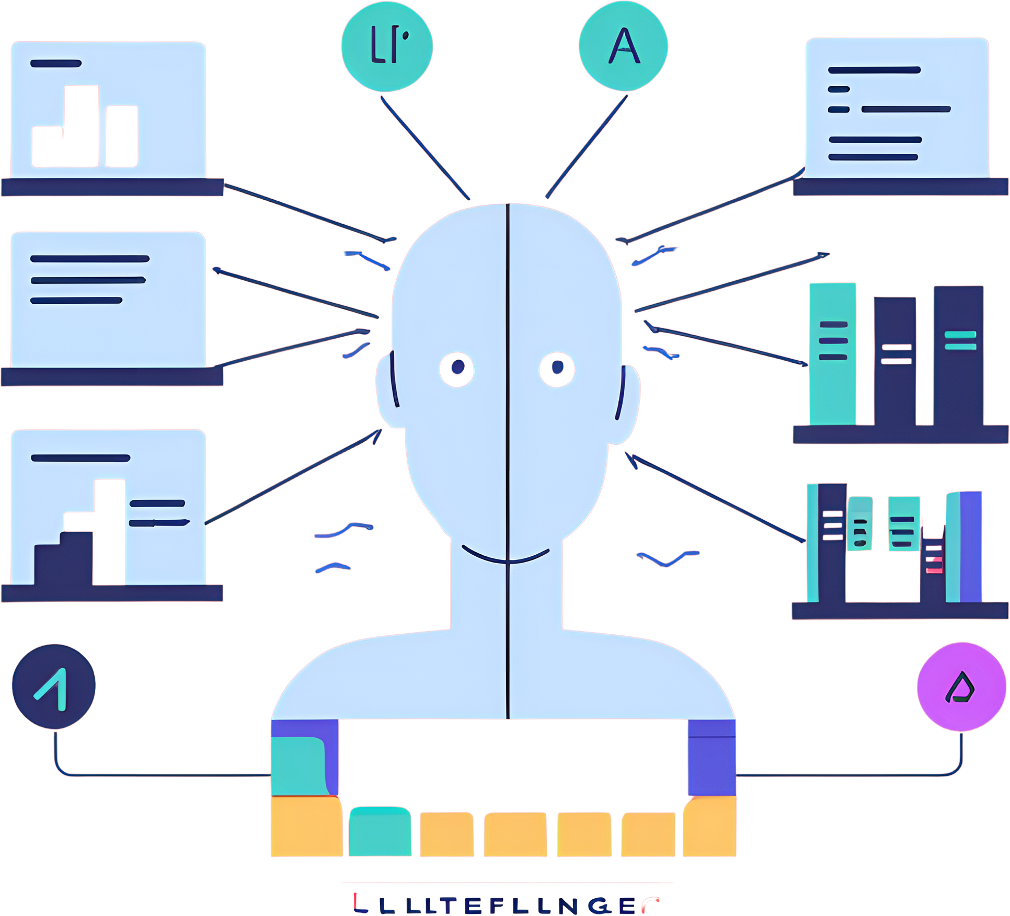
RELATED WORK
According to Research paper “ Title: Computer Vision-Based Library Management System (https://ieeexplore.ieee.org/document/10170541/)”
Traditional methods of managing a library have their disadvantages like long waiting queues and expensive scanner machines. This paper aims to overcome these drawbacks by introducing a new application that makes use of face and text recognition to issue books from the library. The main idea is that a picture of the book with the issuer will be taken from which the required data will be extracted. The account of the user will be created by the library admin by uploading a picture of the face of the user. The application consists of two types of logins - user and admin, where administrators can keep track of user transactions and history. The face recognition algorithm and book recognition algorithm gave an overall accuracy of 99.43% and 82.5% respectively. The user can also see the information related to books and this information is extracted from a third-party API. Further, easy payment and reissue options for the books on the application have also been implemented.

Slide 8
PROBLEM STATEMENT AND OBJECTIVES
Traditional library systems rely heavily on manual, inefficient processes for issuing, returning, and tracking books, which makes it time-consuming and prone to errors. For instance, the library staff has to manually enter details for each book issue and return. Also, Students weren’t notified about the deadlines of returning their books due to which they face consequences. This process can lead to errors such as incorrect entries, lost records, and delays. Our project aims to automated system for streamline operations, reduce manual efforts, minimize errors, and enhance the user experience.

Slide 9


PROJECT ANALYSIS AND DESIGN
Hardware and Software Requirement Specifications
PYTHON
TESSERACT OCR
SQL FOR DATABASE MANAGEMENT
BARCODE READER
A WEBCAM

Slide 10
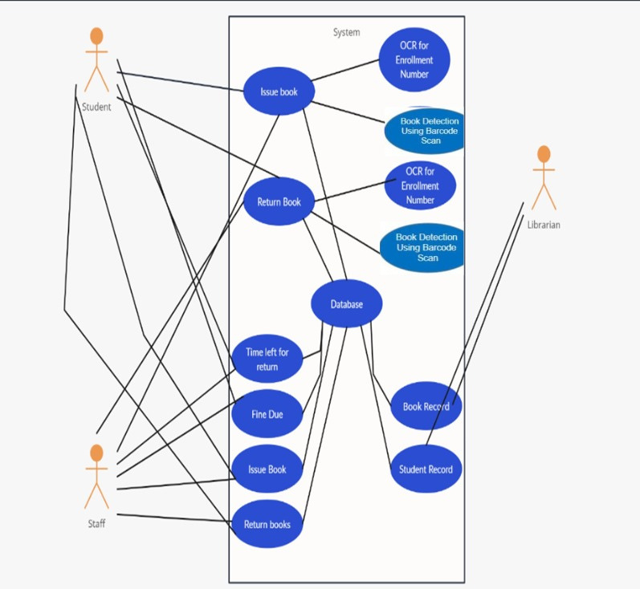
PROJECT ANALYSIS AND DESIGN
Use Case Diagrams

Slide 11
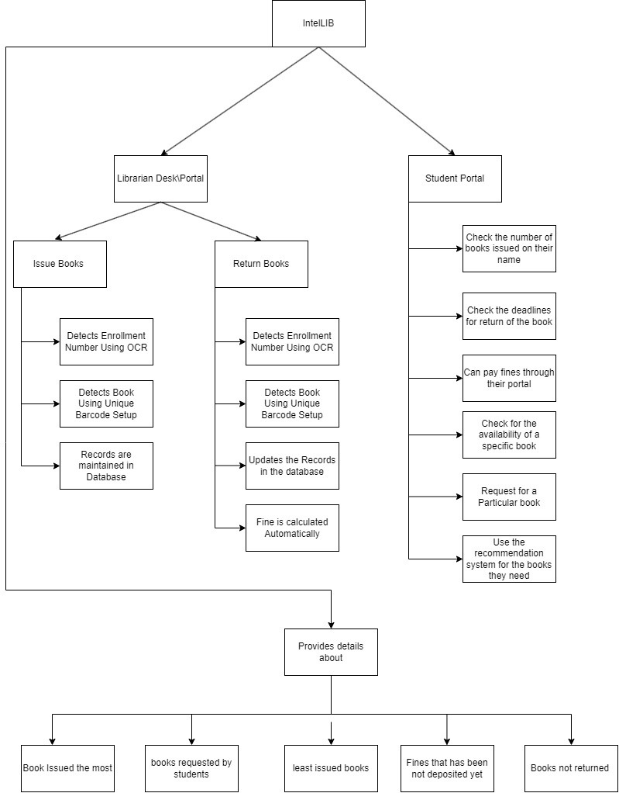
PROJECT ANALYSIS AND DESIGN
Flow Chart

Slide 12
PROPOSED WORK AND METHODOLOGY ADOPTED
Frontend
It is the user interactive part of the model which can be used by both librarians and the students.
Librarian can issue the book using the webcam and Barcode reader which will require the student id card and book for issuing process and same process will be followed for the returning process
Students can access their account details i.e. the fines, deadlines for returning books, the number of book issued.

Slide 13
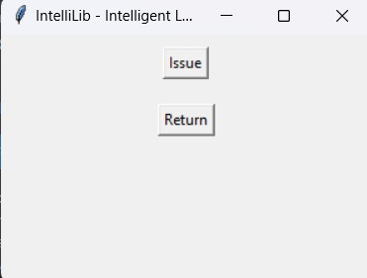
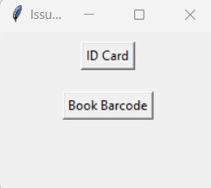
PROPOSED WORK AND METHODOLOGY ADOPTED
Frontend
HOME SCREEN
ISSUE BOOK SCREEN

Slide 14
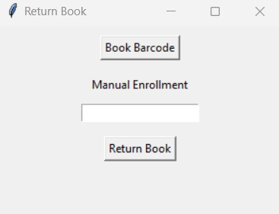
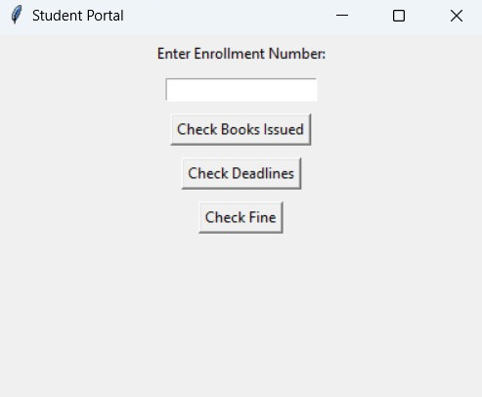
PROPOSED WORK AND METHODOLOGY ADOPTED
Frontend
RETURN-BOOK SCREEN
STUDENT-PORTAL SCREEN

Slide 15
PROPOSED WORK AND METHODOLOGY ADOPTED
Enrollment Number Detection
It includes the use of two python libraries:
Pytesseract- It is a OCR(Optical Character Recognition) tool for python that recognize or read the text embedded in images.
OpenCV- It stands for Open-Source Computer vision Library. It is a library of programming functions mainly for real time computer vision. It is used for accessing the images.
In this step, the enrollment number from the identity cards is detected using the above two tools and then the detected information is stored in the backend.

Slide 16
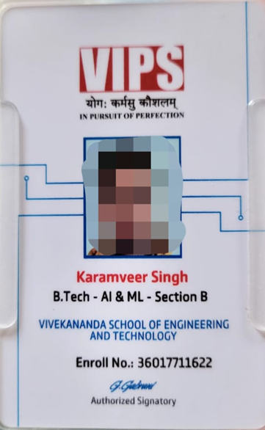
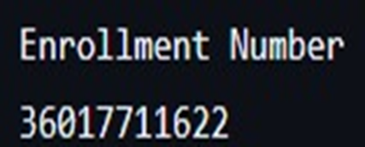
PROPOSED WORK AND METHODOLOGY ADOPTED
Enrollment Number Detection

Slide 17
PROPOSED WORK AND METHODOLOGY ADOPTED
Book Detection Model
The front-end is designed using Tkinter, with multiple frames for different sections (main menu, enrollment capture, and book barcode capture).
User interactions are handled with buttons, allowing transitions between different frames and triggering various functions.
Enrollment Number Capture:
Users capture an ID card image or manually enter an enrollment number using SimpleDialog. This information is stored in the database.
Book Barcode Capture:
The application uses OpenCV to interact with the camera and capture the book barcode image.
Pyzbar decodes the barcode from the captured image.
Once the barcode is detected, it is saved along with the enrollment number to a CSV file, tracking which book is issued to which student.

Slide 18

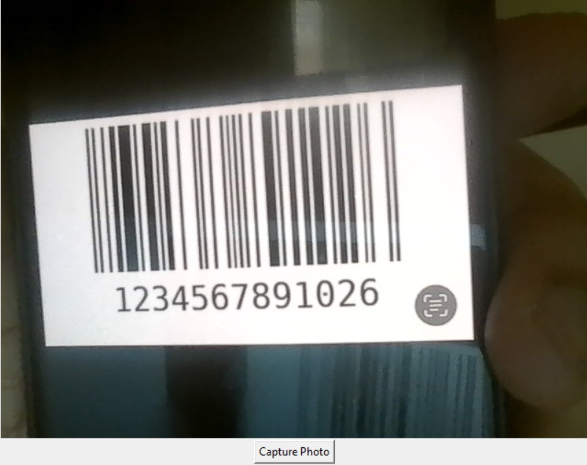
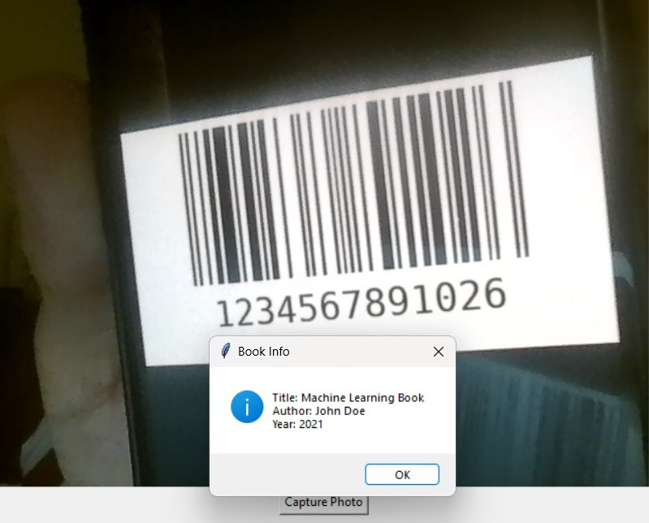
PROPOSED WORK AND METHODOLOGY ADOPTED
Book Detection Model

Slide 19
PROPOSED WORK AND METHODOLOGY ADOPTED
Backend
The backend of this project is implemented using MySQL and Python using MySQL connector.
It includes one database- Intellib having two tables :-
book_issue : It includes all the details of the issued books and the issuer of the book.
student_record : It has all the student details such as names, enrollment number, contact, semester.

Slide 20
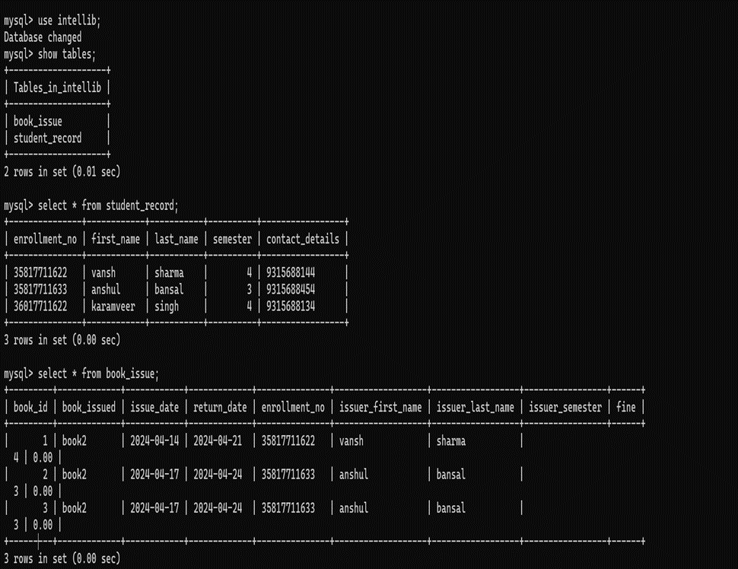
PROPOSED WORK AND METHODOLOGY ADOPTED
Backend

Slide 21
RESULTS AND DISCUSSION
The use of an SQL database provided a centralized repository for storing information about issued and returned books, as well as student enrollment numbers. This allowed for efficient data management and easy retrieval of information when needed.
Time Efficient and Less Prone to Errors
Comparatively Less errors like incorrect entries, lost records, and delays
More Accessible and Efficient for everyone as it is not manual rather focuses on automation
Students got notified about the deadlines and get updated with their library records

Slide 22
CONCLUSION
The IntelliLib project achieved its goals and demonstrated the effectiveness of integrating OCR , barcode and MySQL database technology into library management. The results support the system's continued use and potential expansion in the future. The project's success can also inspire further development, including more advanced integration with existing library management systems and enhanced security measures.

Slide 23

FUTURE SCOPE OF WORK
01
02
03
ACCURACY
DEPLOYMENT
INTEGRATE WITH KOHA
Needs constant working and maintenance to improve efficiency and working.
We are planning to deploy it in our own library for the realtime usage
We will try to integrate with the KOHA(one of the largest library management system) so that we can get our software used worldwide.

Slide 24
REFERENCES
Title: Computer Vision-Based Library Management System (https://ieeexplore.ieee.org/document/10170541/)
Title: Smart library book sorting application with intelligence computer vision technology (https://www.emerald.com/insight/content/doi/10.1108/LHT-10-2019-0211/full/html)
Title: A Machine Learning Based Book Availability Prediction Model for Library Management System (https://digitalcommons.unl.edu/cgi/viewcontent.cgi?article=9274&context=libphilprac)
Title: Applying Image Processing Techniques for Library Management System: A Review (https://ieeexplore.ieee.org/document/9242606)
Title: A Novel Approach for Book Recommendation System Using User Reviews and Ratings with Computer Vision Techniques (http://ieeexplore.ieee.org/document/7684166/)
Title: Library Management System with Enhanced Security Features Using ImageProcessing Techniques (https://ieeexplore.ieee.org/document/9242606)

Slide 25
REFERENCES
Title: Automating Library Processes Using Image Processing and RFID Technologies (https://ieeexplore.ieee.org/document/9668584)
Title: Library Management System with User Friendly Interface Using Image Processing (https://ieeexplore.ieee.org/document/10142904)
Title: Library Management System Using RFID Technology (Title: A Machine Learning Based Book Availability Prediction Model for Library Management System (https://digitalcommons.unl.edu/cgi/viewcontent.cgi?article=9274&context=libphilprac))
Title: Self-service in Libraries: A Review of the Literature (https://www.emeraldgrouppublishing.com/how-to/librarians/librarian-corner)

